Slide 1
Alphalinc Java ORM (Object Relational Mapping)
TASC – the alpha supply chain

Slide 2
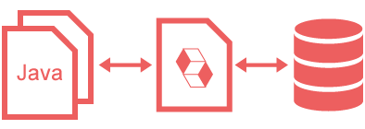
Alphalinc - Java ORM Introdução
JDBC - Java Database Connectivity
JDO - Java Data Objects
JPA - Java Persistence API

Slide 3
Alphalinc - Java ORM Referências
https://db.apache.org/jdo/jdo_v_jpa.html
http://en.wikipedia.org/wiki/List_of_object-relational_mapping_software
http://java-source.net/open-source/persistence
http://hibernate.org/orm/
https://www.eclipse.org/eclipselink/jpa.php
http://www.datanucleus.org/
http://empire-db.apache.org/empiredb/hibernate.htm
http://www.simpleorm.org/
https://cayenne.apache.org/

Slide 4
Alphalinc - Java ORM JDBC
Criado em 1997 (JDK 1.1)
Acesso a bancos de dados relacionais
Arquitetura semelhante ao ODBC
Comandos DDL e DML
Abstração de tipos de dados
Controle do pool de conexões

Slide 5
Alphalinc - Java ORM JDO
Liberado em 2006
POJO (plain old java objects)
Independente do tipo de banco de dados (RDBMS, OODBMS, ...)
Controle de transações
JDOQL - Java Data Objects Query Language
Diversas implementações comerciais

Slide 6
Alphalinc - Java ORM JDO
DataNucleus (*)
JPOX
XCalia
ObjectDB
Speedo
TJDO
(*) Implementação de referência no mercado

Slide 7
Alphalinc - Java ORM JPA
Liberado em 2006 (EJB)
POJO (plain old java objects)
Banco de dados relacionais (RDBMS)
Controle de transações
JPQL - Java Persistence Query Language
Mais utilizado no mercado

Slide 8
Alphalinc - Java ORM JPA
Hibernate (*)
EclipseLink
TopLink (Oracle)
OpenJPA
DataNucleus
ObjectDB
(*) Implementação de referência no mercado

Slide 9
Alphalinc - Java ORM JPA
Persistence Specification Mechanism
Annotations
reverse engineering (*)
added manually
generated class
XML
API (programmatically)
fewer implementations
(*) Mecanismo mais utilizado no mercado

Slide 10
Alphalinc - Java ORM JPA
Transaction Control
Implicit & Explicit Transactions
Version Control & Optimistic Locking
Lock Mode & Pessimistic Locking
JTA (Java Transaction API)

Slide 11

Alphalinc - Java ORM JPA - Alternativas
JPA - POJO – with Annotations
(reverse engineering)
X
JPA - Dynamic Entity Classes
(programmatically)

Slide 12

Alphalinc - Java ORM JPA Annotated POJO
Class Definition (reverse engineering)

Slide 13
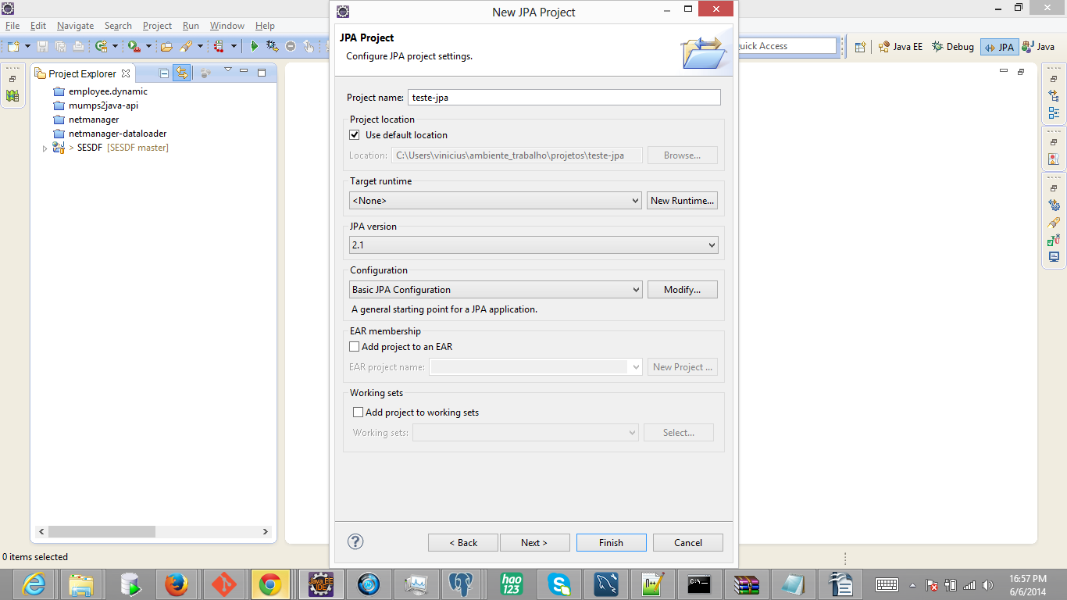
Alphalinc - Java ORM JPA Annotated POJO
Class Definition (reverse engineering)

Slide 14
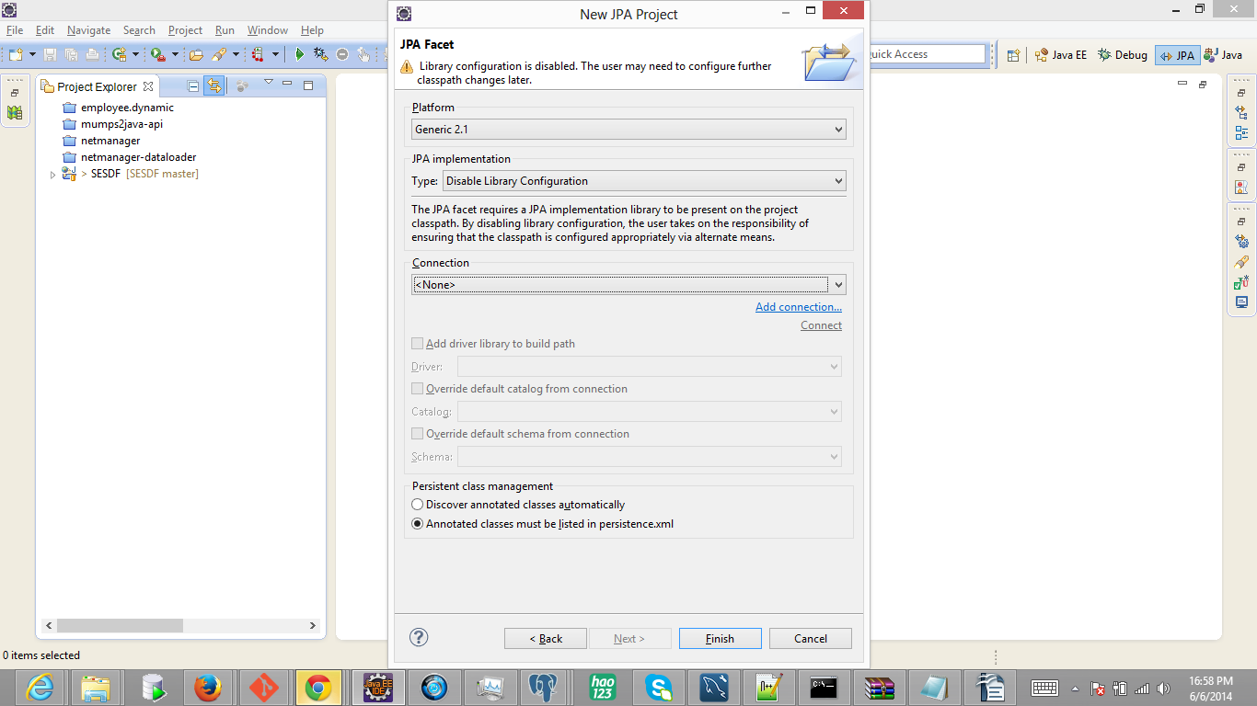
Alphalinc - Java ORM JPA Annotated POJO
Class Definition (reverse engineering)

Slide 15
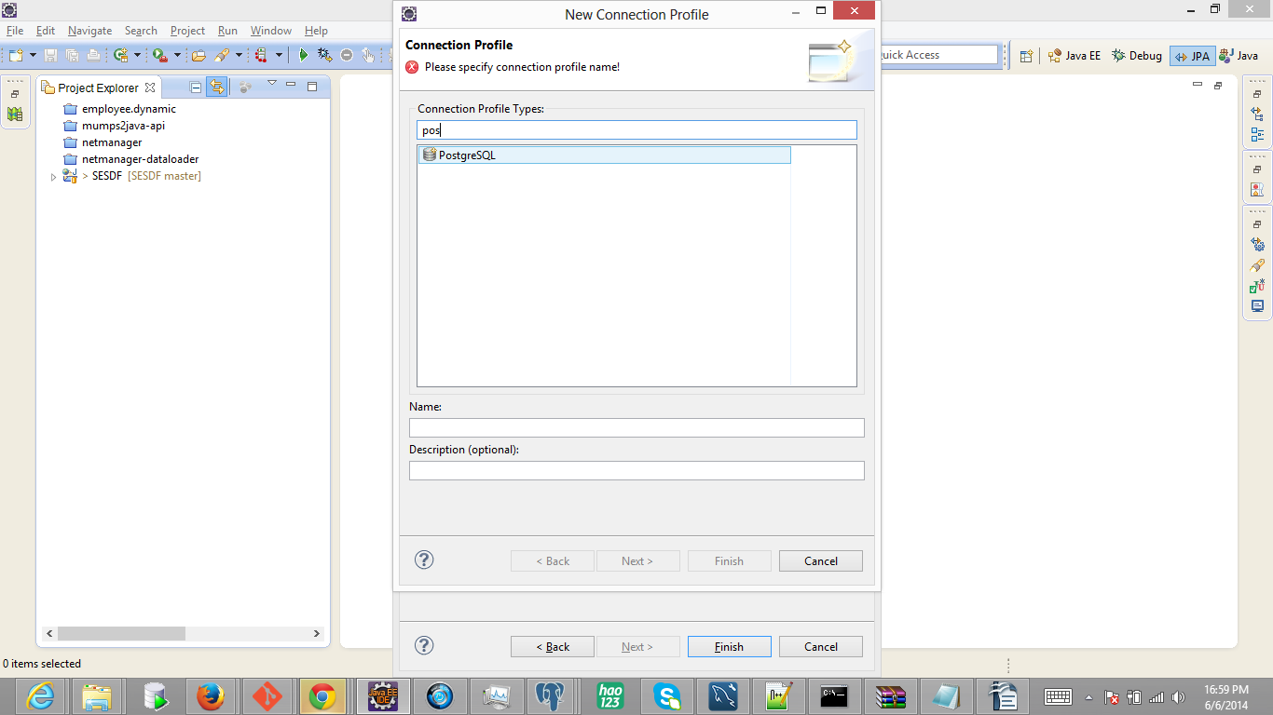
Alphalinc - Java ORM JPA Annotated POJO
Class Definition (reverse engineering)

Slide 16
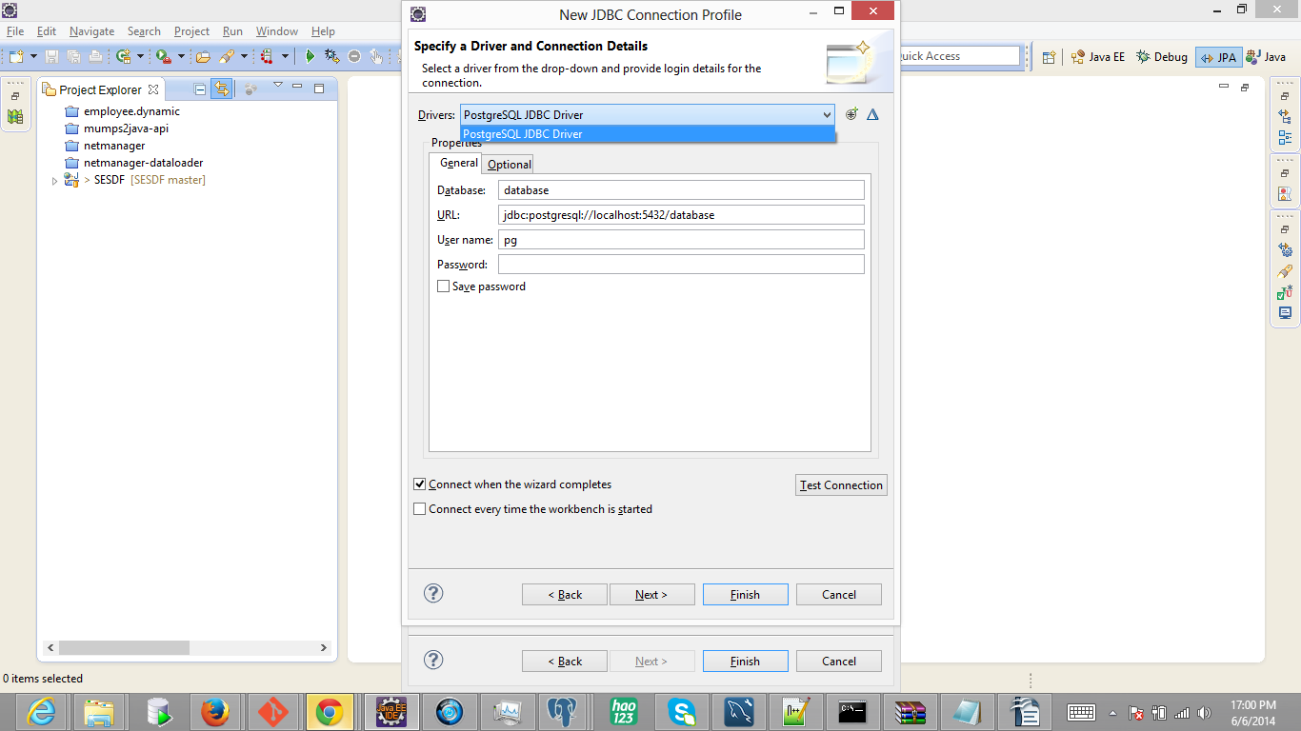
Alphalinc - Java ORM JPA Annotated POJO
Class Definition (reverse engineering)

Slide 17
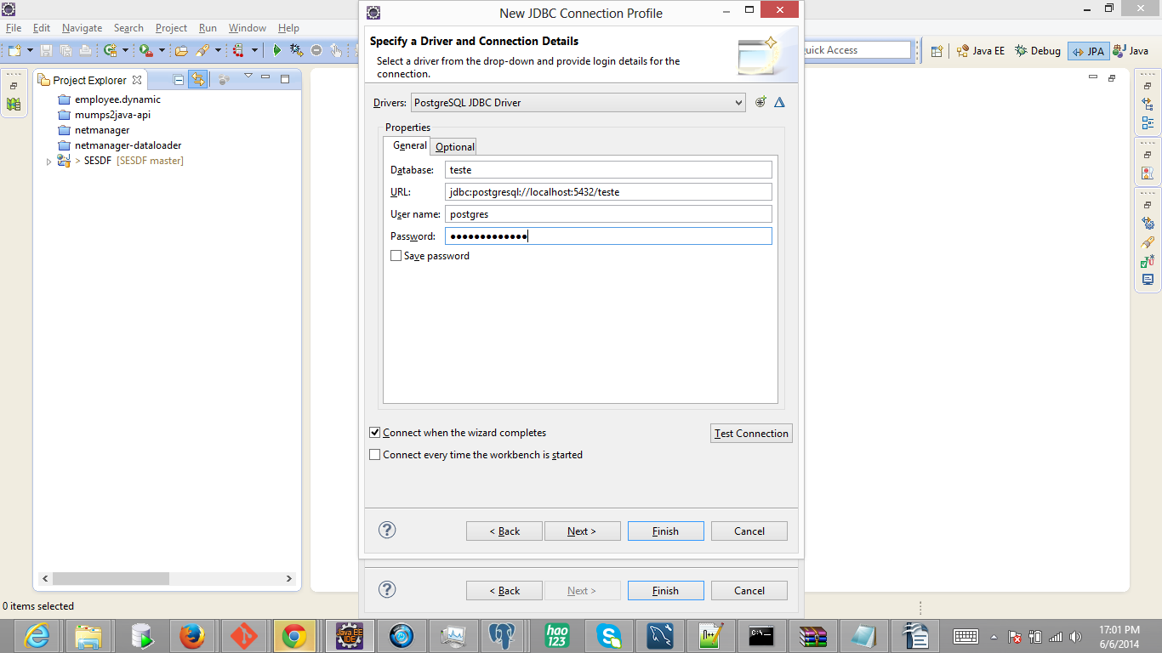
Alphalinc - Java ORM JPA Annotated POJO
Class Definition (reverse engineering)

Slide 18
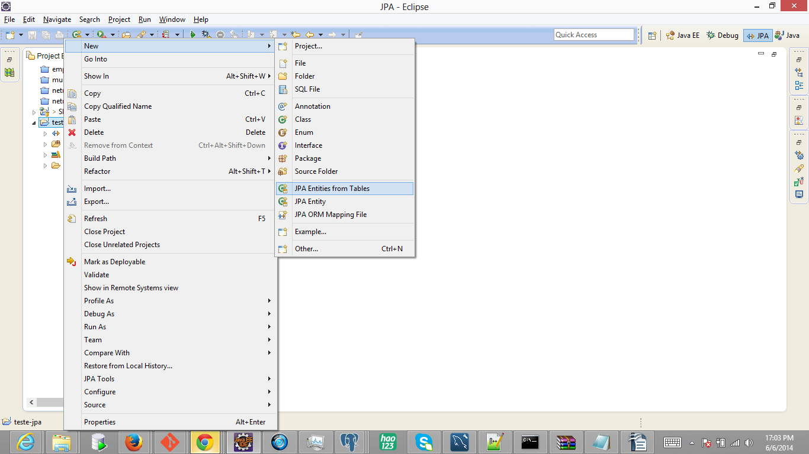
Alphalinc - Java ORM JPA Annotated POJO
Class Definition (reverse engineering)

Slide 19
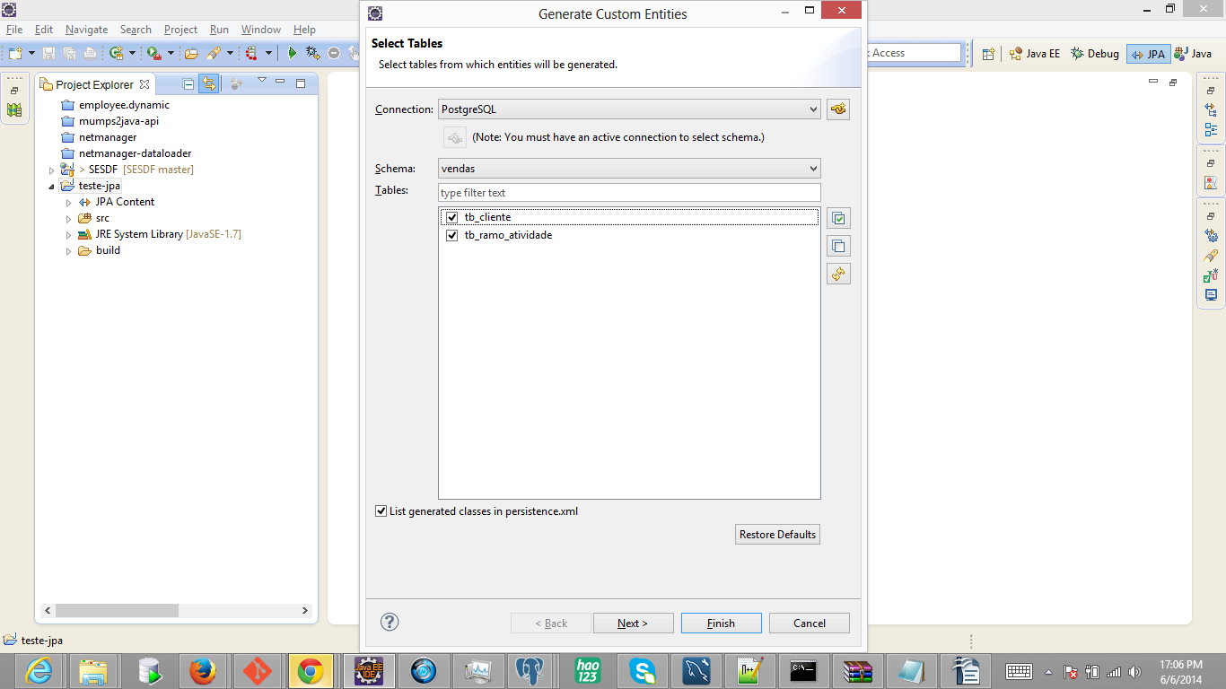
Alphalinc - Java ORM JPA Annotated POJO
Class Definition (reverse engineering)

Slide 20
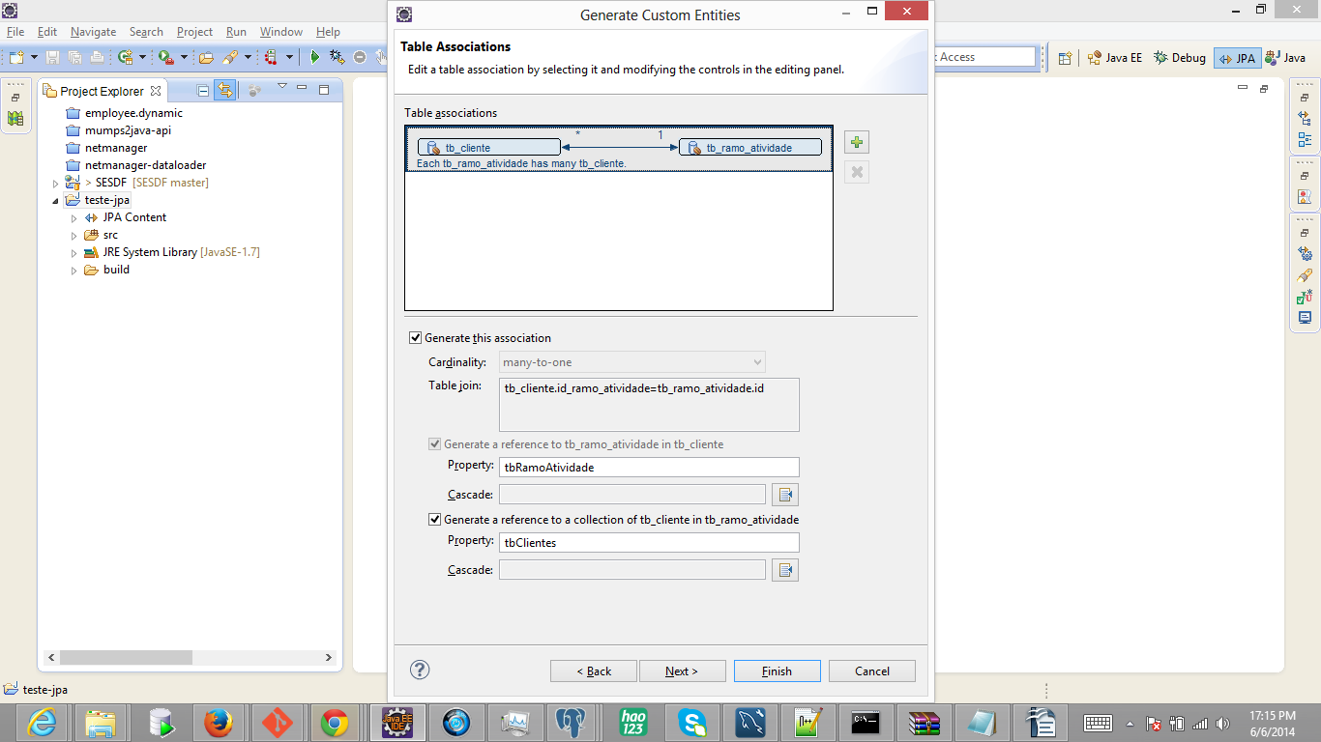
Alphalinc - Java ORM JPA Annotated POJO
Class Definition (reverse engineering)

Slide 21
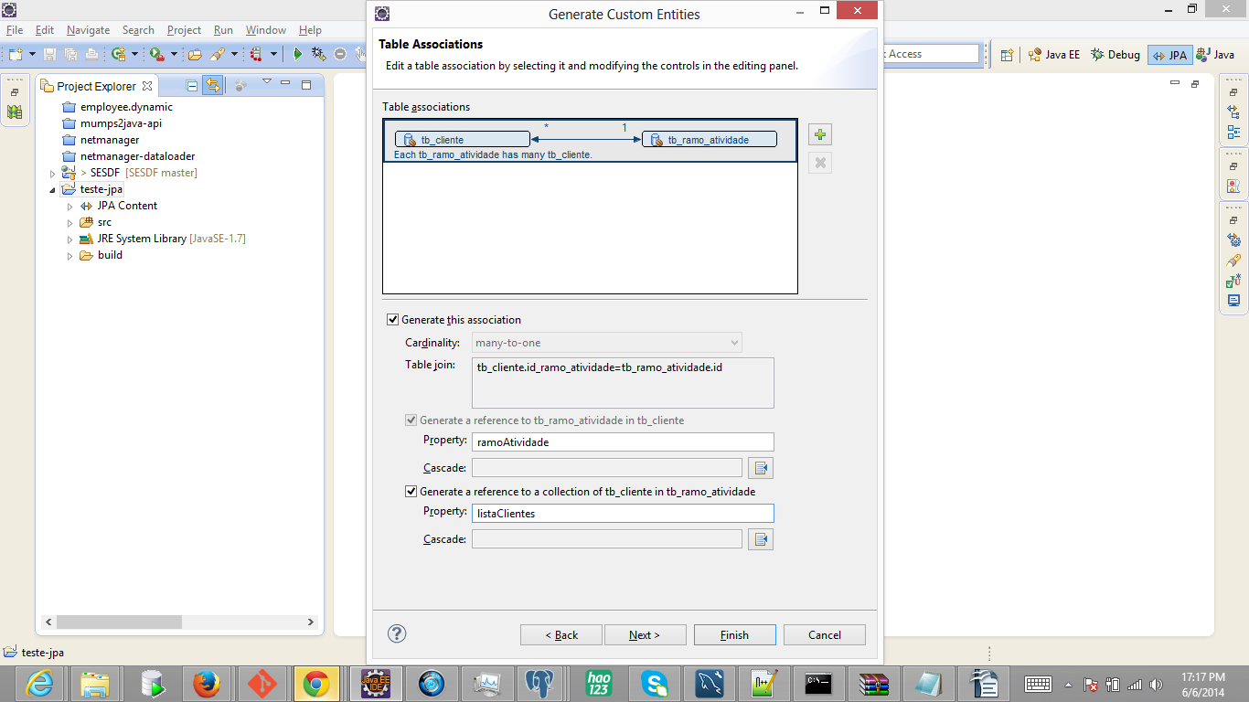
Alphalinc - Java ORM JPA Annotated POJO
Class Definition (reverse engineering)

Slide 22
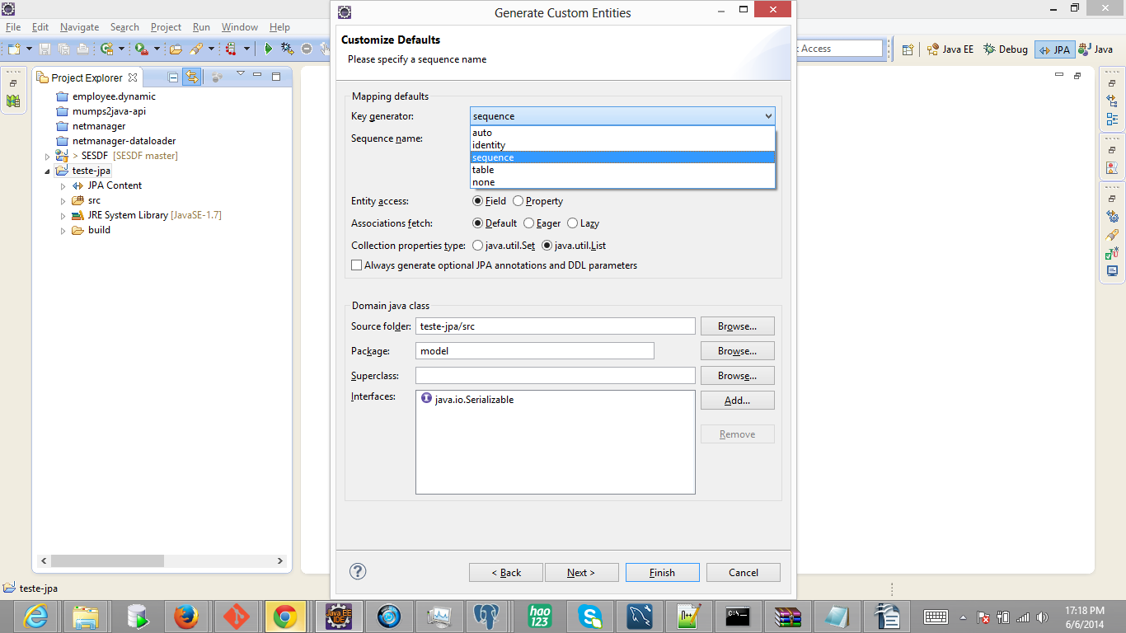
Alphalinc - Java ORM JPA Annotated POJO
Class Definition (reverse engineering)

Slide 23
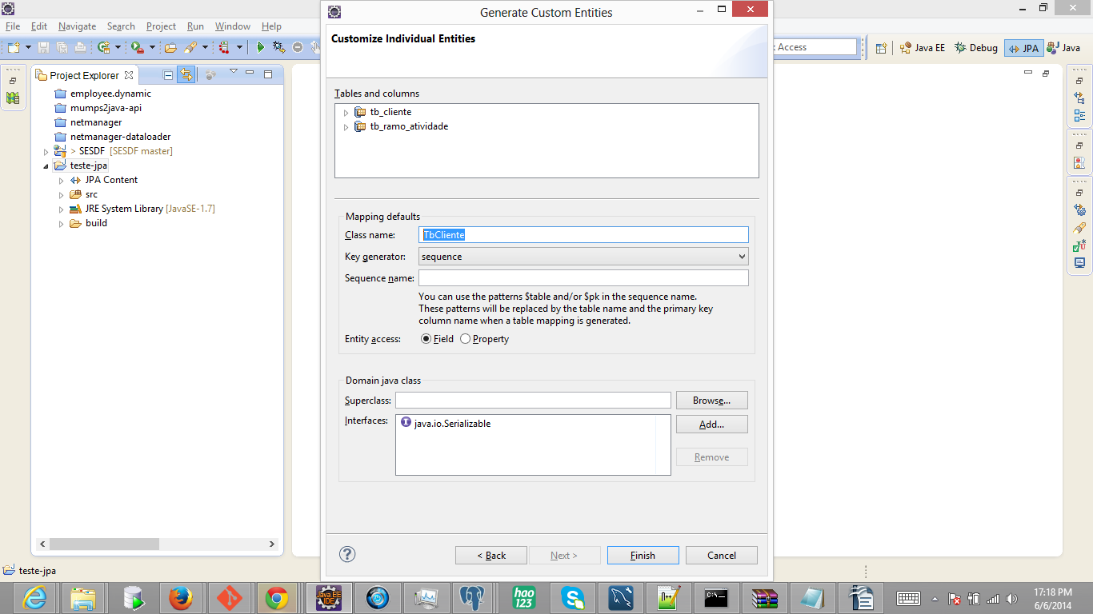
Alphalinc - Java ORM JPA Annotated POJO
Class Definition (reverse engineering)

Slide 24

Alphalinc - Java ORM JPA Annotated POJO
Class Definition (reverse engineering)

Slide 25
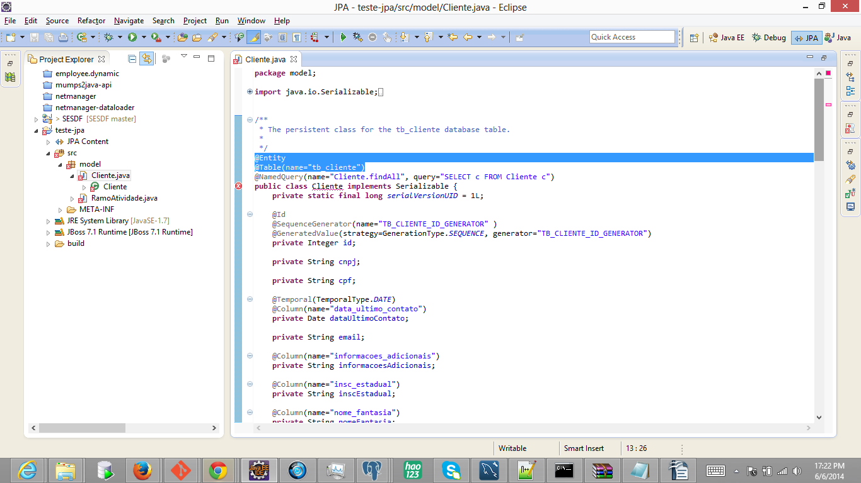
Alphalinc - Java ORM JPA Annotated POJO
Class Definition (reverse engineering)

Slide 26
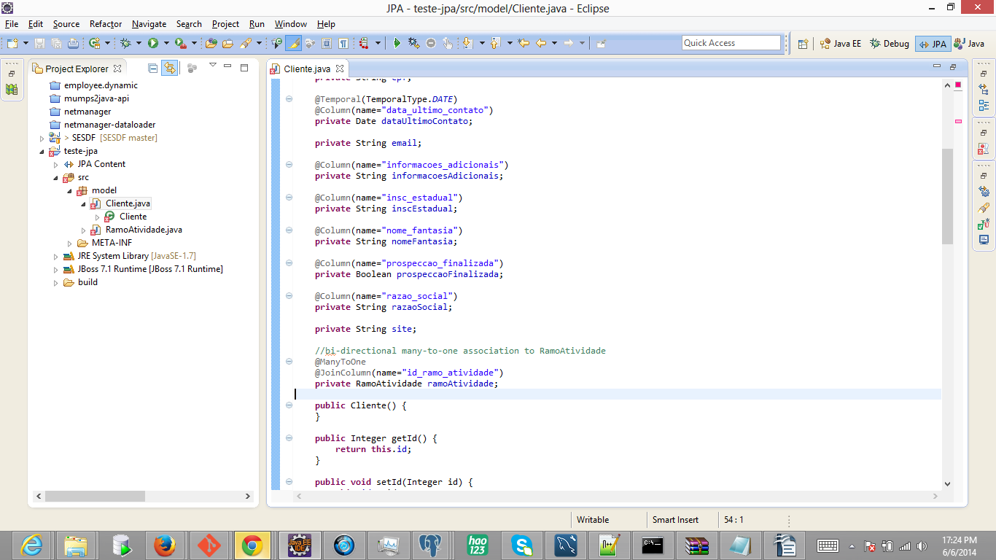
Alphalinc - Java ORM JPA Annotated POJO
Class Definition (reverse engineering)

Slide 27
Alphalinc - Java ORM JPA Annotated POJO
Class Definition (reverse engineering)

Slide 28
Alphalinc - Java ORM JPA Annotated POJO
CRUD – Create
Employee employee = new Employee();
employee.setName(name);
employee.setJob(job);
employee.setSalary(salary);
employee.setDeptno(deptno);
session.save(employee);

Slide 29
Alphalinc - Java ORM JPA Annotated POJO
CRUD – Read (or retrieve)
String queryString = "from Employee where name = :name";
Query query = session.createQuery(queryString);
query.setString("name", "John Mayer");
Employee employee = (Employee) query.uniqueResult();

Slide 30
Alphalinc - Java ORM JPA Annotated POJO
CRUD – Update
String queryString = "from Employee where name = :name";
Query query = session.createQuery(queryString);
query.setString("name", "John Mayer");
Employee employee = (Employee) query.uniqueResult();
employee.setSalary(9000);
session.update(employee);

Slide 31
Alphalinc - Java ORM JPA Annotated POJO
CRUD – Delete
String queryString = "from Employee where name = :name";
Query query = session.createQuery(queryString);
query.setString("name", "John Mayer");
Employee employee = (Employee) query.uniqueResult();
session.delete(employee);

Slide 32
Alphalinc - Java ORM JPA Annotated POJO
Many-to-One Relationship
EntityManager em = entityManagerFactory.createEntityManager();
Order order = em.find(Order.class, 111);
Customer customer = order.getCustomer();
em.close();
entityManagerFactory.close();

Slide 33
Alphalinc - Java ORM JPA Annotated POJO
One-to-Many Relationship
EntityManager em = entityManagerFactory.createEntityManager();
Customer customer = em.find(Customer.class, 100);
Collection<Order> orders = customer.getOrders();
em.close();
entityManagerFactory.close();

Slide 34
Alphalinc - Java ORM JPA Annotated POJO
Triggers
Callback methods (with annotations)
Eventos de controle do NetManager
Eventos configurados para Aplicação
Tipos suportados:
@PrePersist
@PreRemove
@PostPersist
@PostRemove
@PreUpdate
@PostUpdate
@PostLoad

Slide 35
Alphalinc - Java ORM JPA - Alternativas
JPA - POJO – with Annotations
(reverse engineering)
X
JPA - Dynamic Entity Classes
(programmatically)

Slide 36
Alphalinc - Java ORM JPA Dynamic Entity
Class Definition
Não existe a definição da classe
Criação dinâmica em tempo de execução
Utilização do dicionário de dados do NetManager
Utilização da API de forma programática
Totalmente aderente ao padrão JPA

Slide 37
Alphalinc - Java ORM JPA Dynamic Entity
CRUD – Create
mPersistent employee = new mPersistent("Employee");
employee.set("Name",name);
employee.set("Job",job);
employee.set("Salary",salary);
employee.set("Deptno",deptno);
mPersistent.save();

Slide 38
Alphalinc - Java ORM JPA Dynamic Entity
CRUD – Read (or retrieve)
String queryString = "from Employee where name = :name";
Query query = session.createQuery(queryString);
query.setString("name", "John Mayer");
mPersistent employee = (mPersistent) query.uniqueResult();

Slide 39
Alphalinc - Java ORM JPA Dynamic Entity
CRUD – Update
String queryString = "from Employee where name = :name";
Query query = session.createQuery(queryString);
query.setString("name", "John Mayer");
mPersistent employee = (mPersistent) query.uniqueResult();
employee.set("Salary",9000);
employee.save();

Slide 40
Alphalinc - Java ORM JPA Dynamic Entity
CRUD – Delete
String queryString = "from Employee where name = :name";
Query query = session.createQuery(queryString);
query.setString("name", "John Mayer");
mPersistent employee = (mPersistent) query.uniqueResult();
employee.delete();

Slide 41
Alphalinc - Java ORM JPA Dynamic Entity
Many-to-One Relationship
mPersistent order = session.find("Order", 111);
mPersistent customer = order.getObjectReference("Customer");

Slide 42
Alphalinc - Java ORM JPA Dynamic Entity
One-to-Many Relationship
mPersistent customer = session.find("Customer", 100);
Collection<mPersistent> orders = customer.getObjectCollection("Order","Customer");
for(mPersistent order : orders){
order.get(“ID”);
order.get(“XXX”);
}
mPersistent.createClass(“Order”);
“select o from Order o where o.dataInclusao >= :data and o.customer = :customer”

Slide 43
Alphalinc - Java ORM JPA Dynamic Entity
Triggers
Suportadas com total transparência para o desenvolvedor
Eventos de controle do NetManager
Eventos configurados para Aplicação
Tipos suportados:
BeforeSave
AfterSave
BeforeDelete
AfterDelete
AfterLoad

Slide 44
Alphalinc - Java ORM JPA - Comparativo
JPA - POJO – with Annotations
(reverse engineering)
X
JPA - Dynamic Entity Classes
(programmatically)

Slide 45
Alphalinc - Java ORM JPA – Comparativo – Prós
Annotated POJO
Dynamic Entity
Clareza
Legibilidade
Padrão de Mercado
Maior Apoio na Implementação
Flexibilidade
Integridade
Simplicidade
Menor Esforço
Maior Transparência ao Desenvolvedor

Slide 46
Alphalinc - Java ORM JPA – Comparativo – Contras
Annotated POJO
Dynamic Entity
Maior Esforço
Menor Flexibilidade
Menor Robustez
Maior Cuidado na Implementação
Pouca Referência de Mercado

Slide 47
Alphalinc Java ORM (Object Relational Mapping)
Alexandre van den Mosselaar
alexandre@innovatium.com.br
(11) 3044-0209
(11) 98469-2498

